Slide 1
Predictive Modeling
Danny Lumian, Ph.D.
Data Science Training Specialist
Office of Data Science Strategy
National Institutes of Health

Slide 2
Types of Targets
Classification
Target to predict is one of a set of classes
Examples:
Spam or not spam
Type of a flower
Malignant or benign tumor
Regression
Target to predict is numeric/continuous quantity
Examples:
Life expectancy
Cost of housing
Miles per gallon of a car

Slide 3
Three types of variables
Independent Variable
Predictive variable(s)
May be manipulated by researcher, such as conditions in an experiment
Dependent Variable
The outcome or target (y) variable of interest
Controlled Variable
Variable that may impact the outcome or dependent variable
Measured to help ensure rigorous standards for an experiment

Slide 4
Train-Test Split
It is common in machine learning to create a train-test split
The train data is used to train the model
This data is “seen” by the model
The test data is used to evaluate model performance
This data is “unseen” by the model
Test metrics are usually more informative than train metrics as it shows how well the model generalizes its predictions
Common splits are 80/20 or 70/30
Can be useful to stratify data based on target

Slide 5
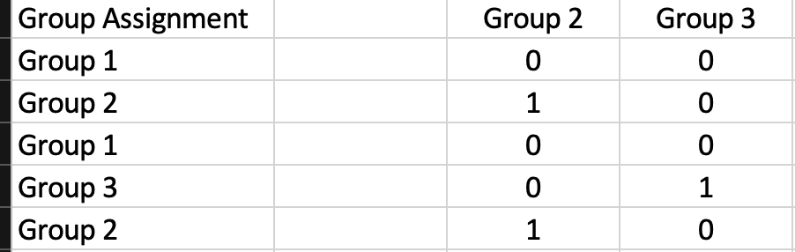
Dummy Coding Variables
Convert categorical variables to a set of binary variables
Drop 1 group as the baseline
All other groups get a new numeric column

Slide 6
Bias and Variance
The bias error is an error from erroneous assumptions in the learning algorithm. High bias can cause an algorithm to miss the relevant relations between features and target outputs (underfitting).
The variance is an error from sensitivity to small fluctuations in the training set. High variance may result from an algorithm modeling the random noise in the training data (overfitting).
From Wikipedia: https://en.wikipedia.org/wiki/Bias%E2%80%93variance_tradeoff

Slide 7
Underfitting vs Overfitting
Underfitting
Overfitting
A model that does not capture the nuance of the data
Example might be a model that just predicts the mean or dominant class
Can add features or try a different model
A model that does not generalize well
Attends to meaningless patterns in the data
Detected by good training metrics but poor test metrics
Can remove features or tune the model

Slide 8
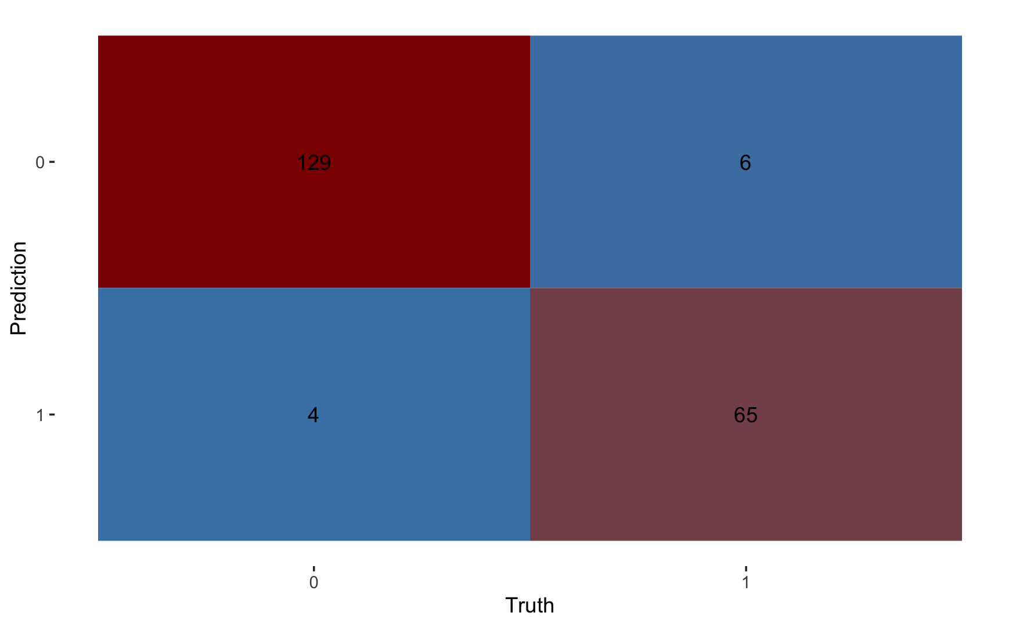
Classification Outcomes
True Negatives (TN)
Top left quadrant
Was not a positive case and was not predicted as a positive case
False Negatives (FN)
Top right quadrant
Was a positive case but was predicted as a negative case
True Positives (TP)
Bottom left quadrant
Was a positive case and was predicted as a positive case
False Positives (FP)
Bottom left quadrant
Was a negative case but was predicted as a positive case

Slide 9
Classification Metrics
Accuracy (TP+TN)/Total
Percentage of total predictions that were correct
Sensitivity (TP/(TP+FN))
True positive rate
Specificity (TN/(TN+FP))
True negative rate
Precision (TP/(TP+FP))
Positive prediction value
F1-Score (2TP/(2TP+FP+FN))
Harmonic mean of precisions and sensitivity

Slide 10
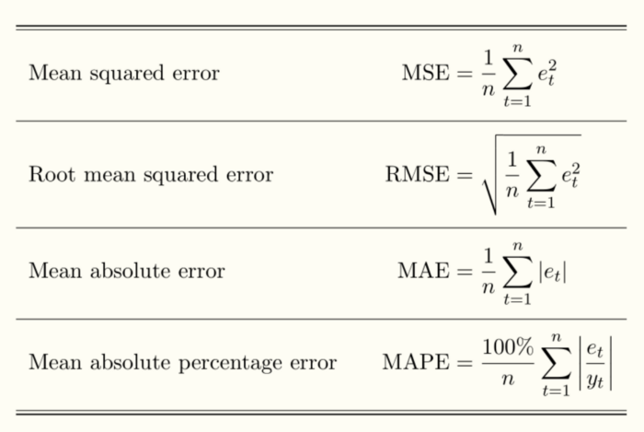
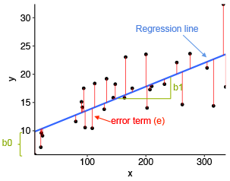
Regression Metrics

Slide 11
Missing Data
Many models can not handle missing data
There are several solutions to address this:
Remove missing data rows
Impute missing data
Example: fill with the mean or most common category
More sophisticated imputation methods exist

Slide 12
Imbalanced Data Sets
Undersample
Remove rows of the more common class
Oversample
Replicate the minority class
Synthetic Data
Create fake data based on observations and use those data in the model

Slide 13
Questions?

